Slide 1




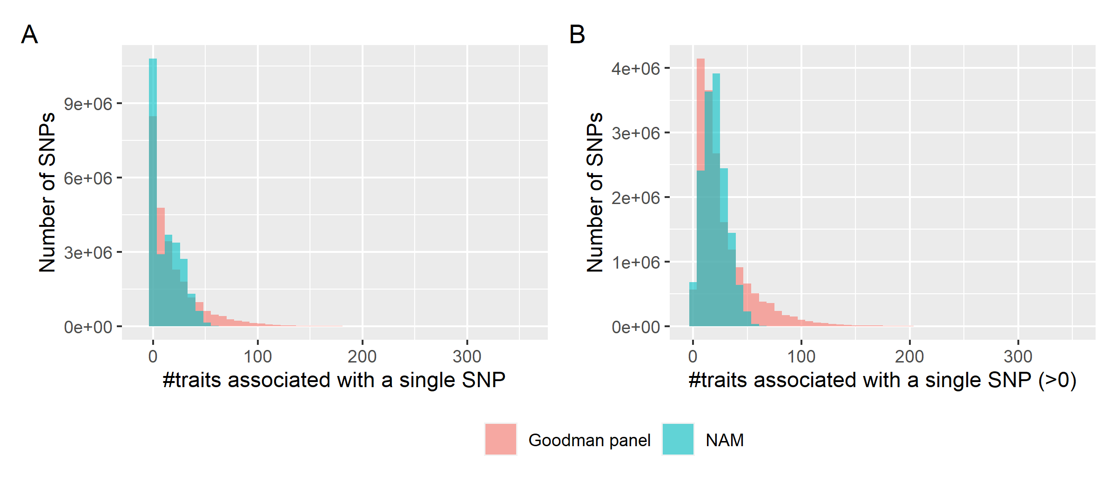
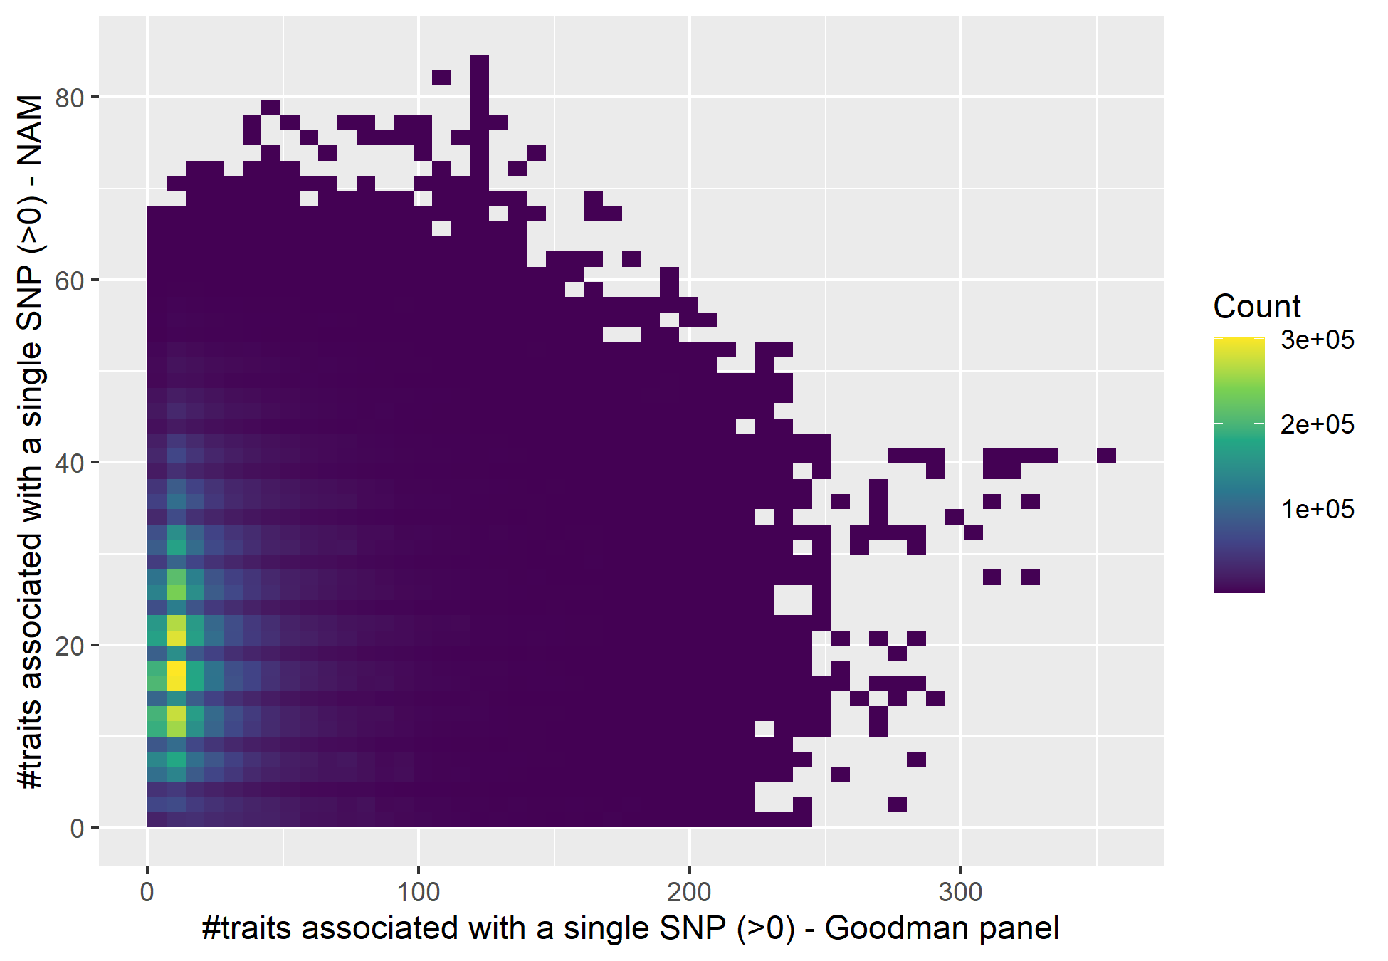


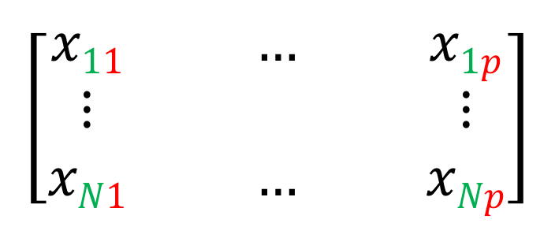
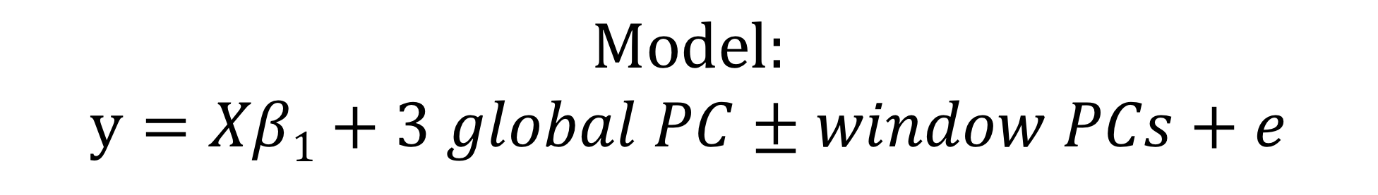
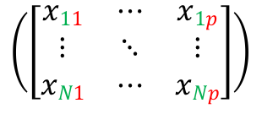
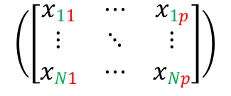
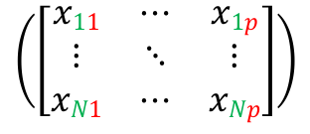

Elucidating the extent of pleiotropy in maize and its functional relevance towards trait prediction
Merritt Khaipho-Burch¹, Anju Giri², Guillaume Ramstein³, Brandon Monier², M. Cinta Romay², Edward S. Buckler^{1,2,3}
1 Section of Plant Breeding and Genetics, Cornell University, Ithaca, NY 14853; 2 Institute for Genomic Diversity, Cornell University, Ithaca, NY USA 14853; 3 Center for Quantitative Genetics and Genomics, Aarhus University, Aarhus, Denmark, 8000 Aarhus; 4 USDA-ARS; Ithaca, NY, USA 14853
mbb262@cornell.edu
Watch the video: https://www.maizegenetics.net/merrittkhaipho-burch
Hypothesis: Due to the shared genetic architecture of traits across maize populations, pleiotropy is common & widespread among quantitative traits
Methods
Results
Phenotypes
30-40% SNPs have no trait associations
~19 traits associate with a single SNP
Counts of previously published phenotypes in NAM and the Goodman Association Panel
DNA
RNA
Protein
Metabolite
26 million
n = 250,000
n = 3,200
Field
n = ~400
Association Mapping
$$Model:$$
$$y=Xβ1+3 global PC±window PCs+e$$
No correlation between NAM and Goodman Panel trait-SNP associations
Watch the video & learn more
p shared SNPs between Ames and NAM/282
PCA
PCA
PCA
R²=0.0078, p = 2.2e-16
Spearman R = -0.094
Break genome into
360 gene windows
$$\left(\left[\begin{matrix}x11 & ⋯ & x1p \\ ⋮ & ⋱ & ⋮ \\ xN1 & ⋯ & xNp\end{matrix}\right]\right)$$
$$\left(\left[\begin{matrix}x11 & ⋯ & x1p \\ ⋮ & ⋱ & ⋮ \\ xN1 & ⋯ & xNp\end{matrix}\right]\right)$$
$$\left(\left[\begin{matrix}x11 & ⋯ & x1p \\ ⋮ & ⋱ & ⋮ \\ xN1 & ⋯ & xNp\end{matrix}\right]\right)$$
N taxa
$$\left[\begin{matrix}x11 & & … & & x1p \\ ⋮ & & & & ⋮ \\ xN1 & & … & & xNp\end{matrix}\right]$$
Chrom start
Chrom end
Capture enough PCs to explain equal amount of variance
Map Ames PCs to NAM/282 population
Map traits
Pleiotropy Estimation
Pleiotropy Formula:
Number of traits within an interval scaled by the number of traits and GWAS hits genome wide.
Discussion & Future Directions
$\frac{\# of unique traits within interval}{total number of mapped traits} x$ $\frac{\# of GWAS hits within interval}{total \# of GWAS hits genome wide}$
Inferring pleiotropy & causal relationships at the SNP level is confounded by linkage disequilibrium
Pleiotropy resolution at the haplotype level may be more plausible
Trait 1
Trait 2
Trait 3
Least pleiotropic
interval
Most pleiotropic interval
Chrom start
Interval 1
Interval 2
Interval 3
Interval 4
Interval 5
Chrom end
Funding Acknowledgements: National Science Foundation, Plant Genome Research Project IOS#1822330; United States Department of Agriculture – Agricultural Research Service; Cornell University, Cornell Recruitment Fellowship

